Slide 1
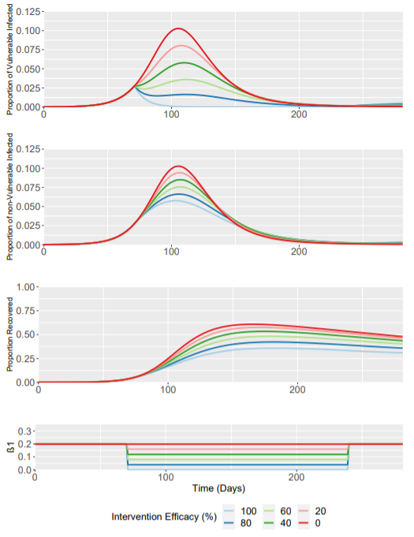
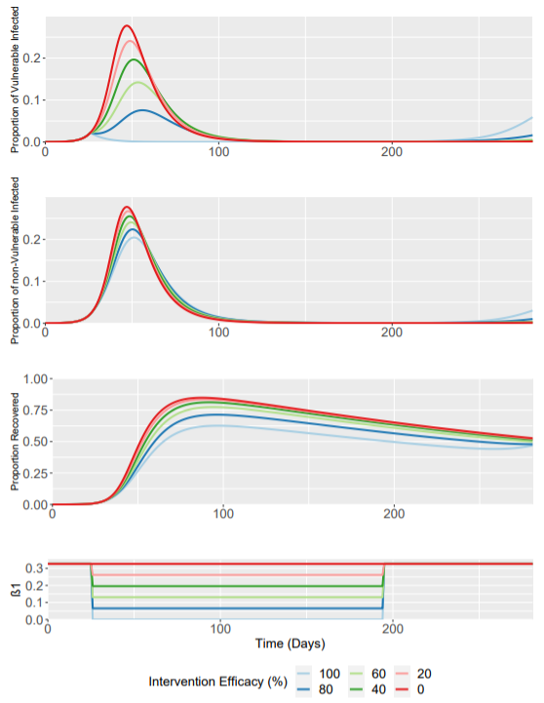
Higher baseline R0 =2.8
Baseline (R0 = 1.7)
R0 = 2.8
Trigger day is now day 26 where I(t) = 0.022.
This is the closest possible to the original baseline trigger I(t) of 0.028 at day 71.
Note the much higher Y-axis values

Slide 2
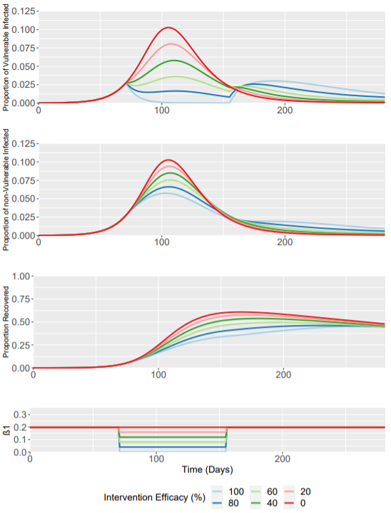
Shorter Intervention
Baseline (24 Week Intervention)
12 Week Intervention

Slide 3
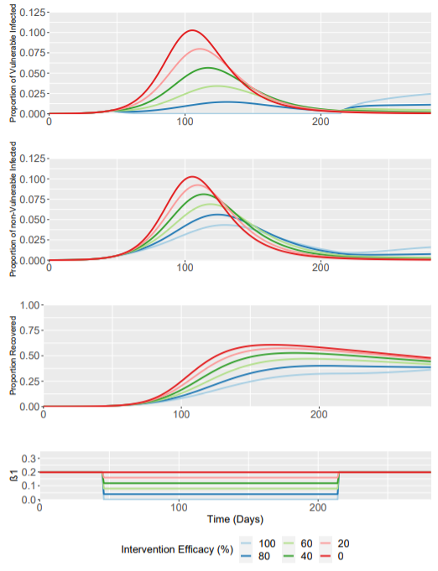
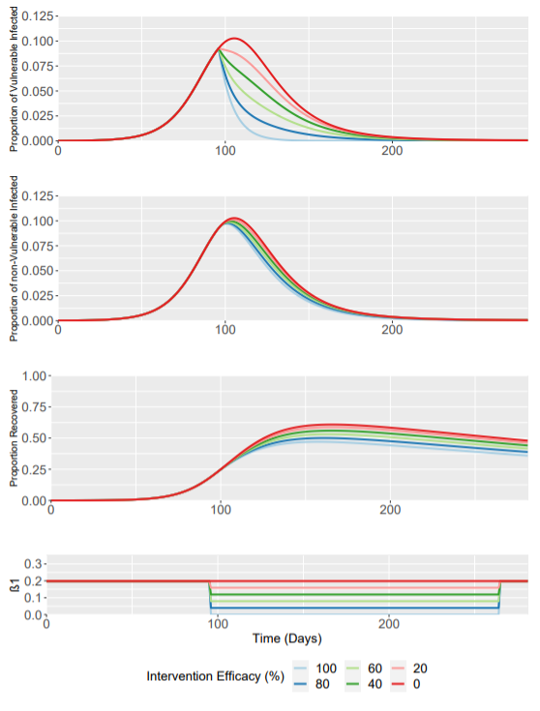
Different Intervention Times (±25 Days from 71 Days)
46 Days
Baseline (71 Days)
96 Days

Slide 4
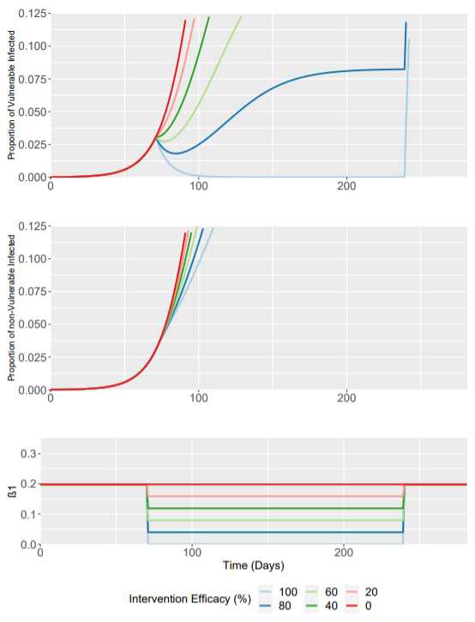
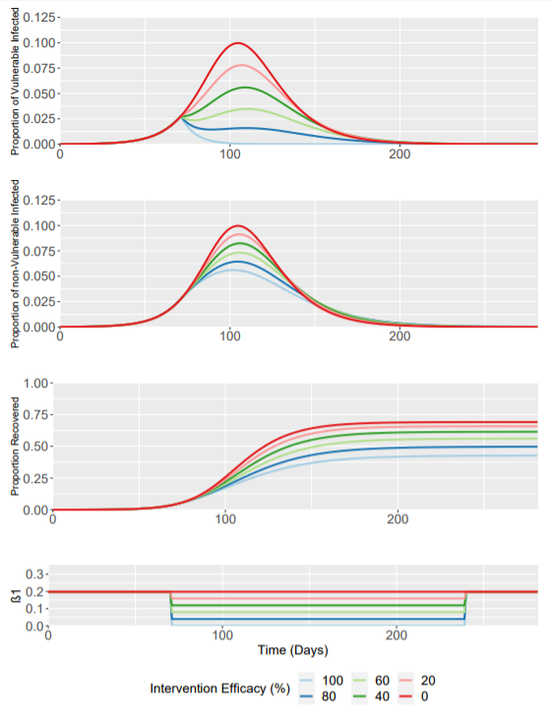
SIS vs SIRS vs SIR
SIS
SIRS
SIR

Slide 5
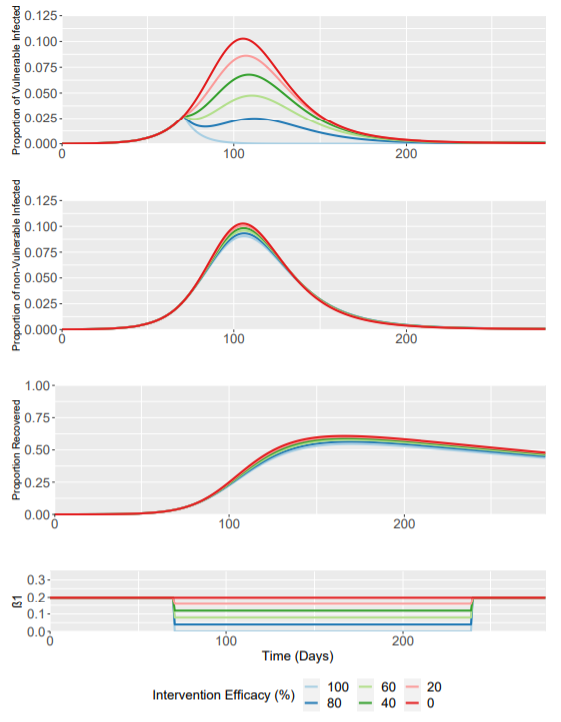
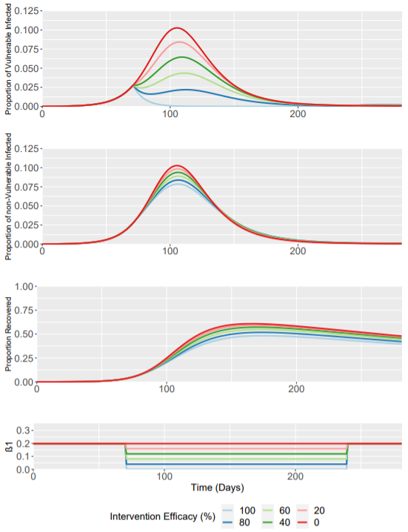
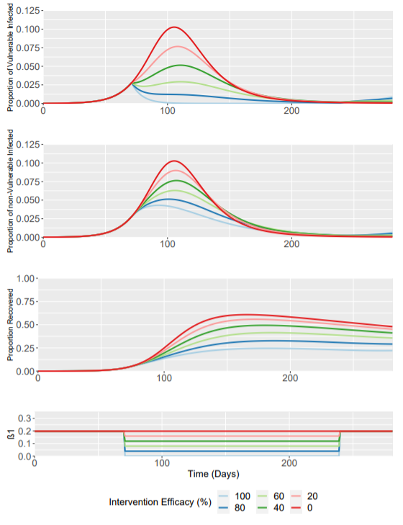
Changes to the Fraction Vulnerable
0.05
0.1
0.2
0.3

